Slide 1
Power BI Administration Solutions
Brett Powell

Slide 2

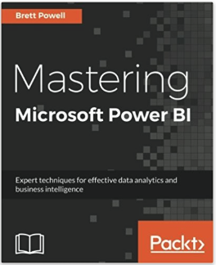
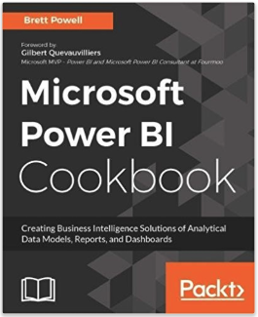
About Me
BI Consultant
Frontline Analytics
Author
Mastering Power BI
Power BI Cookbook
Blog
Insight Quest
PUG Leader
Boston BI
Contact Info:
@BrettPowell76
Brett.Powell@FrontlineAnalytics.net

Slide 3
Session Agenda
Introduction to Power BI Architectures and Artifacts
Introduction to Power BI Admin Tools
Power BI Admin Portal, Premium Metrics Apps
PowerShell Module and REST API
Sample Solutions
Power BI Tenant Artifact Reporting
On-Premises Data Gateway Monitoring
Dataset Refresh History and Group Email Notification
Azure Resource Management
Analysis Services Tabular Model Processing

Slide 4
Introduction to Power BI Architectures and Artifacts

Slide 5
Common Power BI Architectures
Which BI modeling tool?
Is the Data Gateway needed?
Where to publish/consume content?
If Power BI Service, is Premium Capacity needed?
# | SSAS Tabular | Azure AS | Data Gateway | PBI Report Server | PBI Service | PBI Premium Capacity | PBI Embedded Capacity
1 | No | No | Yes | No | Yes | Yes | No
2 | Yes | No | Yes | No | Yes | Yes | No
3 | No | Yes | Yes | No | Yes | Yes | No
4 | Yes | No | No | Yes | No | No | No
5 | No | Yes | No | No | Yes | Yes | No
6 | No | Yes | No | No | Yes | No | Yes
Notes:
Power BI Datasets as modeling tool, publish to service
Using SSAS as modeling tool
Migrated SSAS to Azure so now you’re just refreshing your model through gateway
Fully on-premises – Power BI Report Server
Fully in the cloud – Azure AS, no gateway since data warehouse is
PBI Embedded

Slide 6
Common Custom Admin Solutions
Power BI Dataset Refresh Jobs
On-Premises Data Gateway Monitoring
Office 365 Audit Log Retrieval and Analysis
SSAS or Azure Analysis Services Processing Scripts
Power BI Artifact Reporting
Azure Resource Management Jobs
Power BI Workspace Management Scripts
Azure Active Directory Reporting or Integration
Power BI Dataset Refresh History Reporting

Slide 7
Power BI Artifacts
Workspaces
Containers of reports, dashboards, datasets, dataflows
1:1 relationship with apps
Datasets
Data models (AS Tabular internally)
1 or many data sources per dataset
Reports
Interactive, detailed analysis
1:1 relationship with datasets
Dashboards
At-a-glance consolidated view
1 or many reports per dashboard
App Workspace
Dashboards
Azure Cloud Usage
Cloud Usage Overview
AWS Cloud Usage
Reports
Azure Usage Details
Cloud Usage Details
AWS Usage Details
Datasets
Cloud Usage Analytics

Slide 8
Introduction to Power BI Admin Tools

Slide 9
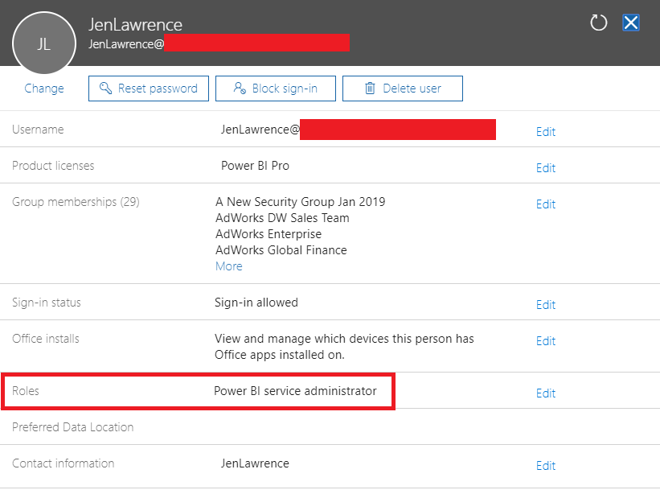
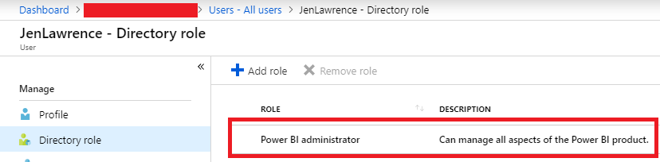
Power BI Admin Role
Power BI Service Admin role:
full control over PBI tenant and admin features excluding licenses
Read/write workspaces without being a workspace member/admin
Manage premium capacities
Create and manage premium capacity nodes
Monitor resources, assign/remove workspaces
Set tenant settings
Map security groups to features
Align to security and governance policies
O365 Admin Center
Azure AD

Slide 10
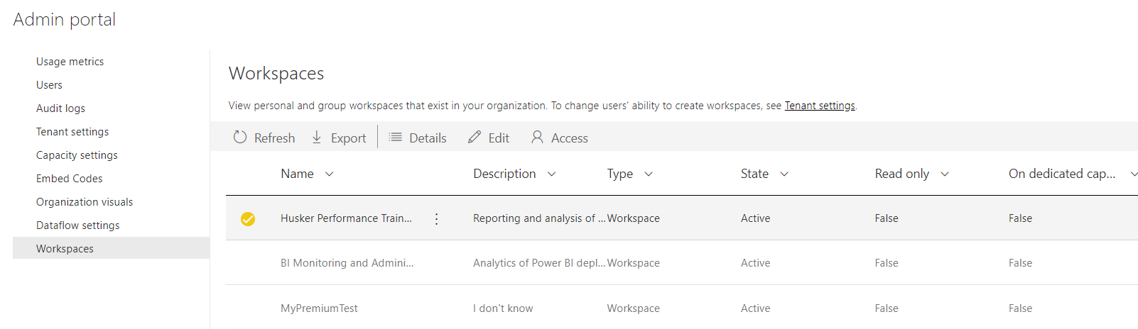
Power BI Admin Portal
Main Graphical interface for common Power BI Admin tasks
Three main pages:
Tenant Settings, Workspaces, Capacity Settings
Power BI Admin Portal: Workspaces Page

Slide 11
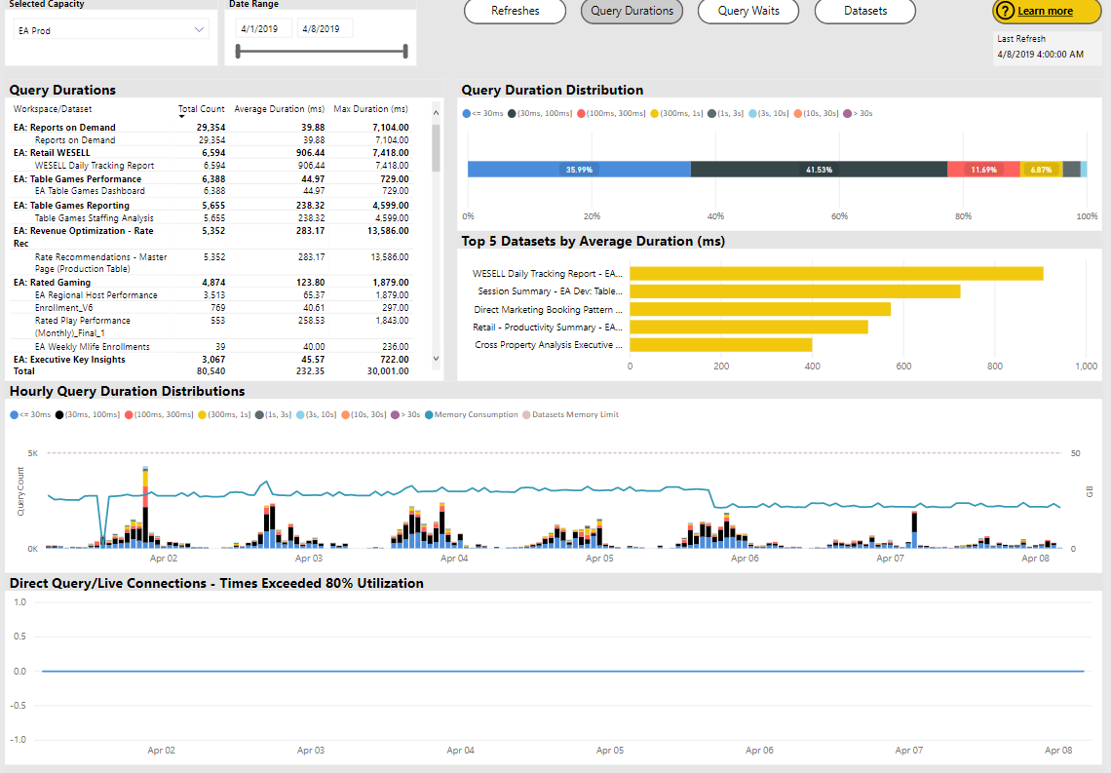
Power BI Premium Metrics App
Free Power BI app to install
Dataset Analysis
Query Performance
Refresh Reliability
Resource Usage
Evictions
% of Memory?
New Premium Workloads
Dataflows
Paginated Reports
Power BI Premium Metrics App

Slide 12
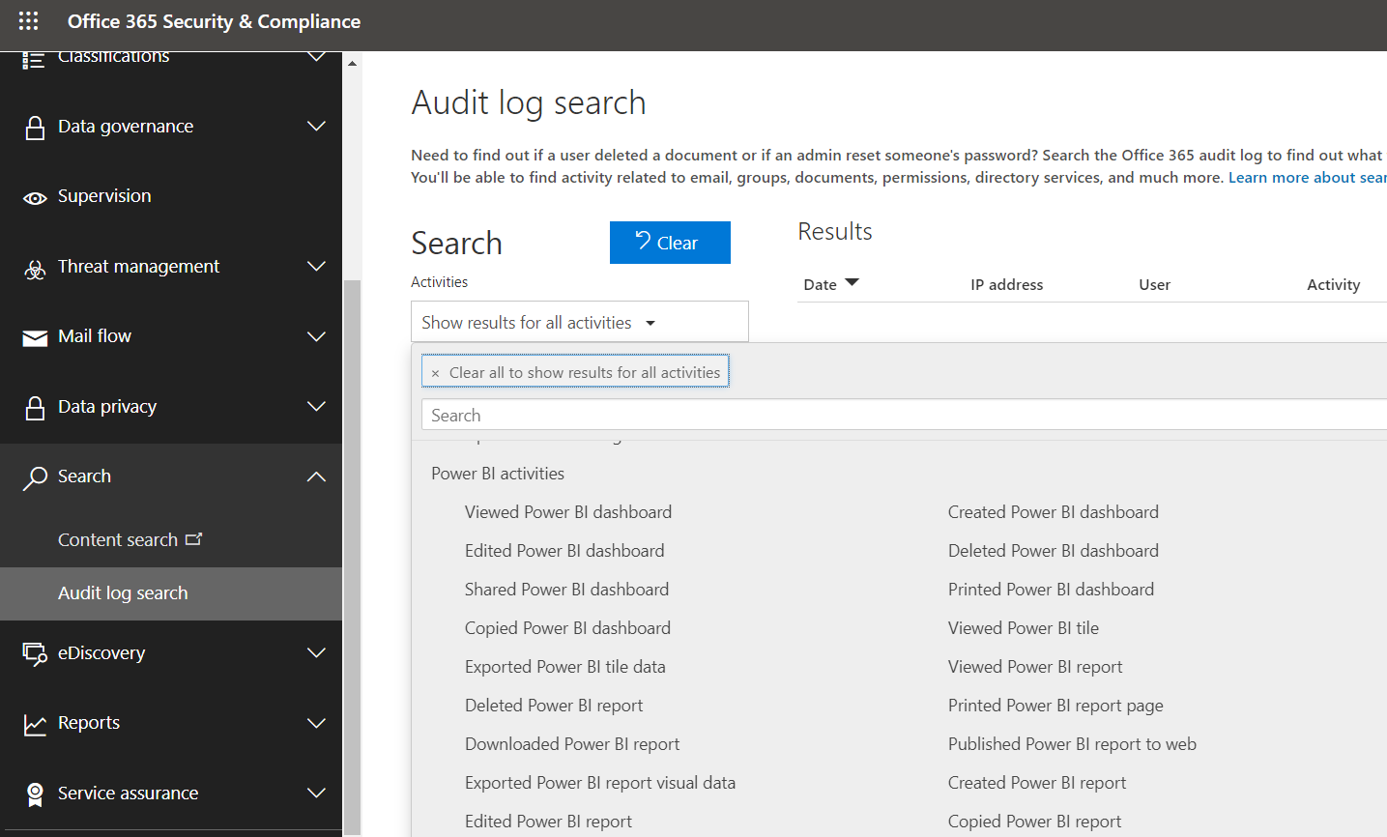
Office 365 Audit Logs
Security & Compliance Center
Link from O365 Admin Center
Search and Export
Very limited - # of events, rows retrieved 1K
Alternatives:
In-House Solution:
PowerShell or O365 Management API
Power BI Usage Metrics Solution Template
Audit Log Search

Slide 13
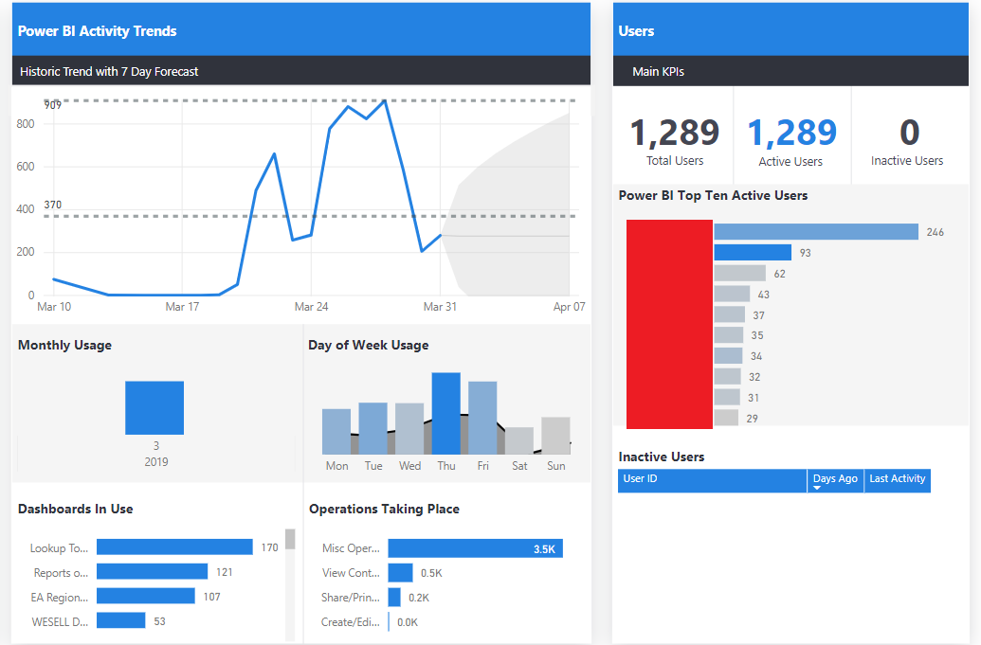
Power BI Usage Metics Solution Template
Pre-Built Solution by Neal Analytics
Deploys an Azure Function App to Retrieve Power BI Audit Events from O365
Stores Data in Azure SQL DB
Out-of-the-box Power BI report against data
Option to leverage Azure SQL DB and reporting to customize
Integrate data with Azure Active Directory
Load other dimension data to SQL DB
Write new DAX metrics and create new visuals

Slide 14
Power BI Admin Solutions

Slide 15
Power BI Management Module and REST API
Power BI Management Module
Power BI REST API Endpoints
Start small, build up to admin solutions
Admin Solutions
Scheduled Scripts/Jobs
Integrate with other applications (PBI, Flow)
Analytics and business logic
Custom alerts and distribution/emails
Invoke-PowerBIRestMethod
Writing data to files
Refreshing datasets or models
Learn, Iterate, Adapt
Get-Workspace
Ad Hoc Admin Scenarios

Slide 16
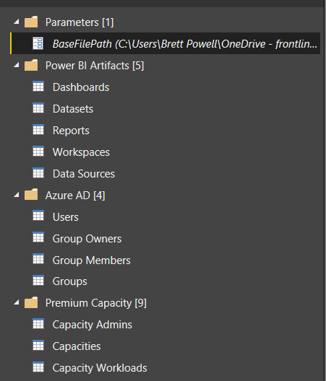
Power BI Artifact Tenant Reporting
Create PowerShell scripts that write artifact details for entire tenant to files
Power BI Management Module
Azure AD Module
Import PBI and AAD Data to Power BI
Power Query expressions for JSON files
Optionally enhance/extend source data
Model relationships between artifact tables
Datasets (one) to Reports, Sources (many)
Premium capacities (one) to workloads, admins (many)
Azure AD Groups (one) to owners, members (many)

Slide 17
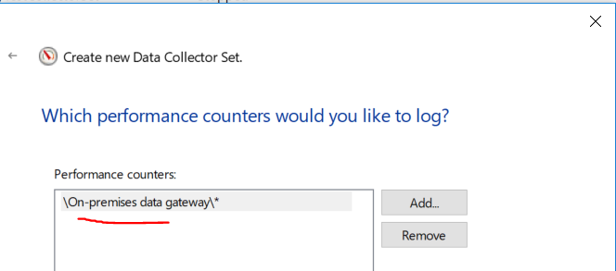
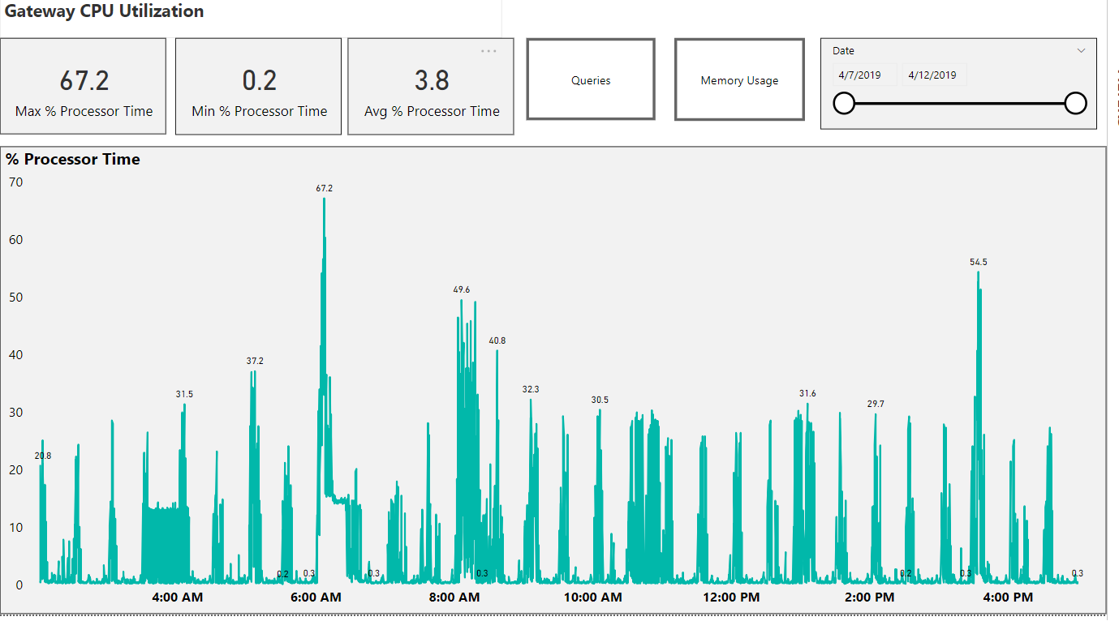
On-Premises Data Gateway Monitoring
Retrieve performance monitor counters to assess health of gateway and gateway server
CPU, Memory, Query Volume, Query Failures
Import to Power BI via Folder.Files() Connector
Parameterize Source Path
Add columns and set data typesd
Visualize and Publish to Power BI
Add basic metrics (max, average)
Build report visualizations
Configure gateway data source for refresh

Slide 18
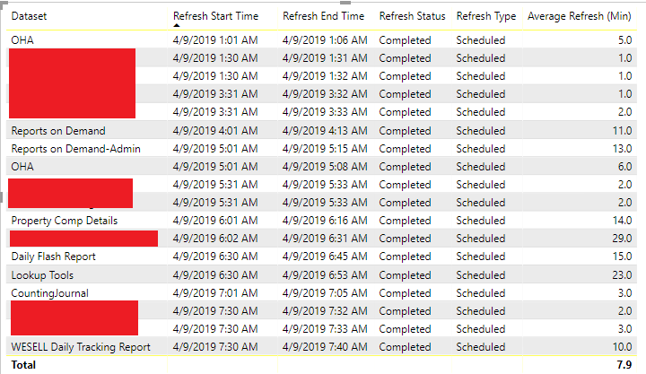
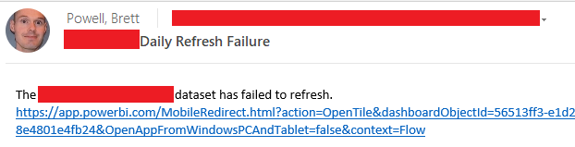
Dataset Refresh History and Group Email Notify
Create PowerShell scripts that write refresh history data to files (JSON) for high priority datasets
Retrieve and consolidate dataset history files via Power Query
Build essential reports including today’s failures
Use card visuals filtered to a specific dataset
Pin card visuals from report to dashboard
Create data alerts for each dashboard card
Create MS Flows to drive group email based on alert

Slide 19
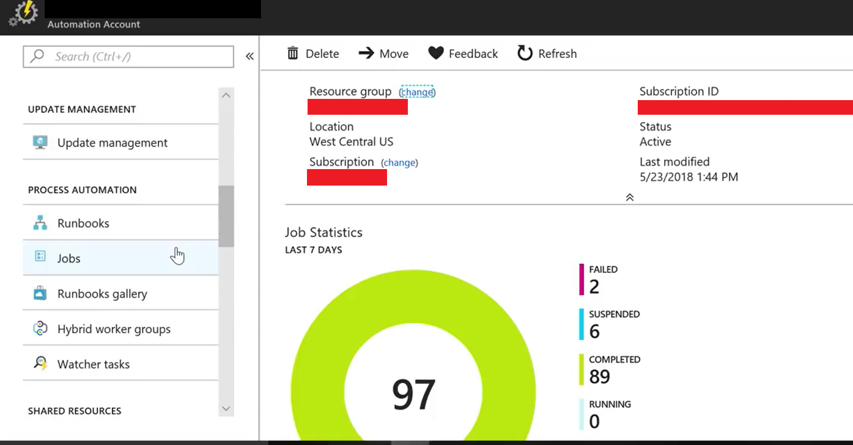
Azure Resource Management
Create PowerShell scripts to manage BI supporting resources (Azure Analysis Services, PBI Embedded)
Pause, Resume, Scale Up, Scale Down
Schedule scripts according to policies or drive based on other events
Azure Automation Runbooks
SQL Server Agent
Examples:
Scale Up on Monday morning
Scale Down in evenings
Pause on weekends
Azure Automation

Slide 20
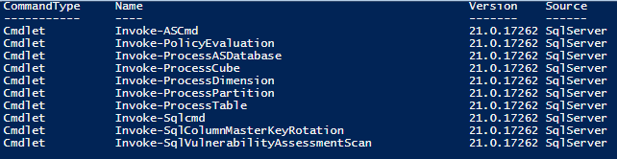
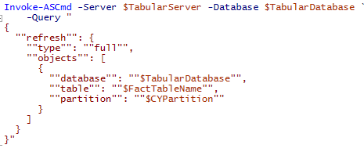
Analysis Services Tabular Model Processing
Analysis Services cmdlets included in SQLServer module
Invoke-ASCmd to pass custom TMSL to server
Can blend PowerShell dynamic logic/variables with TMSL
Analysis Services PowerShell Reference
Analysis Services Processing Cmdlets in SQL Server Module
In-line TMSL Command via Invoke-ASCmd Cmdlet

Slide 21














Support Our Sponsors

Slide 22
Local User Groups
Orange County Data Professionals
2nd Thursday of each month
6:30—8:30 PM
Irvine
BigPASS.pass.org
Los Angeles SQL
3rd Thursday of each odd month
7:00—8:30 PM
USC Campus
Sql.la
Orange County Power BI
3rd Thursday of the month
7:00—8:30 PM
Irvine
Meetup.com
Malibu SQL
3rd Wednesday of each month
6:30—9:00 PM
sqlMalibu.pass.org
San Diego User Groups
1st & 3rd Thursday
6:00—8:30 PM
www.meetup.com/sdsqlug
Los Angeles—Korean
Every other Tuesday
8:00—9:00 PM
El Segundo
sqlAngeles.pass.org

Slide 23
Appendix

Slide 24
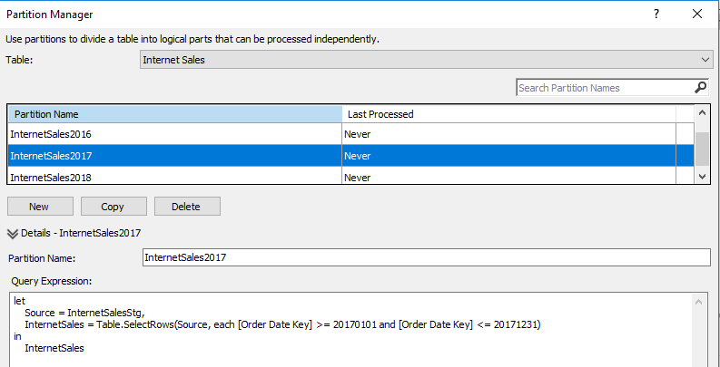
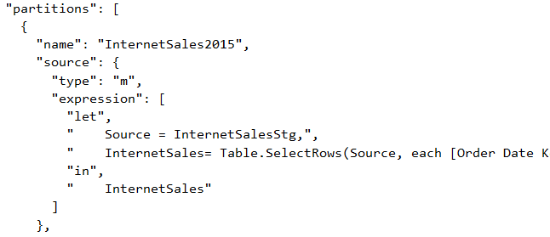
Table Partitions
Defined Rows of a Table
1+ partition per table
1+ segment per partition
8M rows per segment (default) compressed
1 CPU Core per segment in parallelized queries
Avoid Over-Partitioning
Primary Use Case:
Reduce processing time and resources
Improve manageability
Other Use Case:
Consolidate source data
Partition Manager in SQL Server Data Tools (SSDT)
Code View of Model.bim in SSDT

Slide 25
Processing Patterns Overview
Patterns are primarily driven by:
Processing time window
Availability of model for queries
Available RAM during processing job
Other Factors:
Impact on source systems
Available skills (PowerShell, TMSL)
Performance Optimizations
Manageability
 | Simple | Intermediate | Advanced
Model Size | Small | Medium | Large
Transactions | 1-2 | 2-5+ | Many
Operation Types | Full Only | Mixed – Data & Recalc | Diverse, Dynamic
Partitions | None | Years, Months, or Weeks | Days, Multiple Grains
Scripting | None to Minimal | Cmdlets or Simple TMSL | Custom
Automation | N/A | Periodic Maintenance | Fully Automated
Tabular Processing Job Patterns

Slide 26
Processing Approach Examples
Single Process Full of Database
Maximum memory (2X+ of database) and time to process
Multiple Process Full Transactions
Maintain availability for queries,
Reduce memory required for process
Multiple Process Data and Process Recalc Transactions
Eliminate unnecessary Recalc operations
Include Recalc in same transaction to maintain availability
Process Clear Transaction followed by Process Full or Data + Calc
Significantly reduce memory of processing
Include Recalc in same transaction to maintain availability

Slide 27
Best Practice: Keep Model Queryable
Eliminate unavailability, even if refresh process fails
Process Data and Clear transactions result in unavailability
Two options to implement:
Process Full operations exclusively
Include Process Recalc in same transaction as Process Data or Clear
Secondary Option:
Process Recalc in transaction immediately following Process Data or Clear
Unavailability period limited to duration of Process Recalc

Slide 28
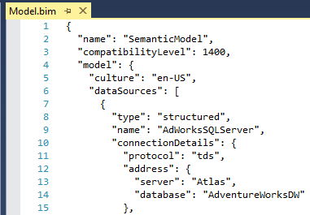
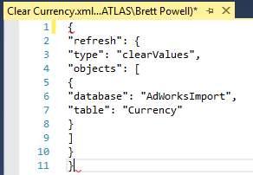
Tabular Model Scripting Language (TMSL)
Command and Object Model Syntax for Tabular databases
1200 Compatibility Level+ (SSAS 2016)
Refresh Command
Type parameter (“full”, “dataOnly”,…)
Sequence Command
Batch Mode: Multiple operations in single transaction
Some model properties exclusive to TMSL
Store TMSL Scripts in XMLA Files
Reference XMLA files from PowerShell
Provides full control over processing
Multiple process operations in single transaction
Control/limit parallelization
TMSL Reference
Code View of Analysis Services Project in Visual Studio
TMSL in XMLA Query File

Slide 29
Azure Automation
Hub for automation and orchestration
Integrate and manage Tabular processing with other processes
Runbooks: Scripts
Jobs: Executions of the runbook
Variables: Manage common values for Runbooks
Triggers: Methods to launch a Runbook
Schedule, Separate Runbook, PowerShell....
Hybrid worker: Execute runbooks in on-premises environment
Azure Automation

Slide 30
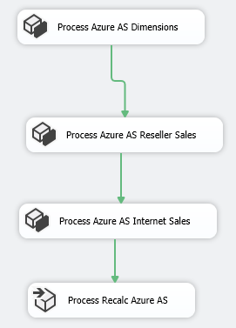
SQL Server Integration Services (SSIS)
Build SSIS Packages Containing Processing Tasks
Align Processing with Data Warehouse ETL/ELT
Leverage SSIS features (checkpoints, logging, email…)
Analysis Services Tasks
Analysis Services Processing Task
Analysis Services Execute DDL Tasks
Pass custom TMSL command inline or via file
PowerShell script via Execute Process taskUse with Azure AS or SSAS
SSIS Package with Processing Tasks

Slide 31
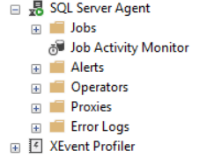
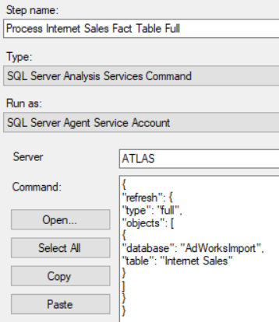
SQL Server Agent
Leverage familiar job scheduling and management tool
Link Processing job to DW or ETL jobs
Processing Job Step Types:
Analysis Services Command
PowerShell Script
SSIS Package
Option to use job steps as transactions
SQL Server Agent
Agent Job Step

